Slide 1
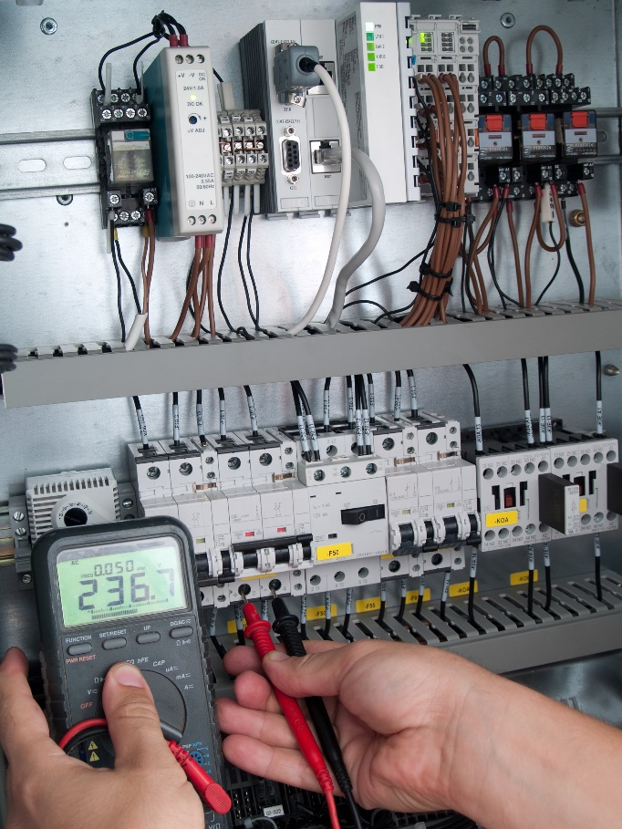
Unit Testing
Test Driven Development
?

Slide 2
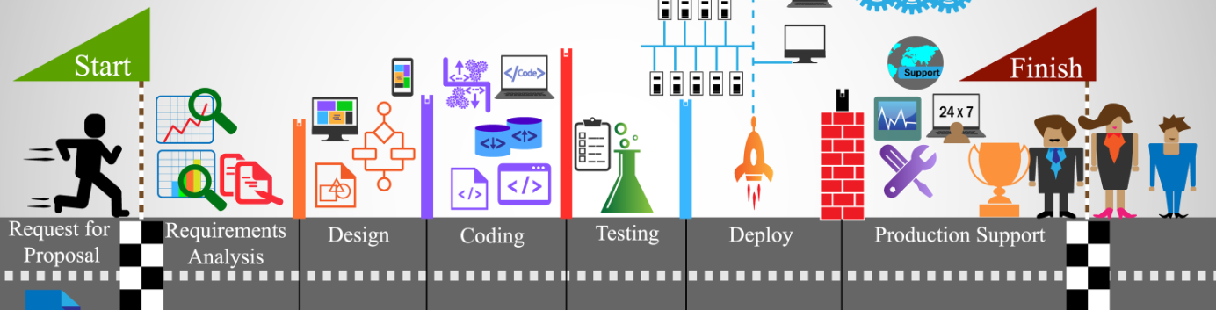
See Also
https://en.wikipedia.org/wiki/Test-driven_development
https://www.geeksforgeeks.org/unit-testing-python-unittest/
Notes:
Here is some additional reading about the web … on the web

Slide 3
Frameworks
TODO RobotFramework, etc. built into python. Jenkins.

Slide 4
Tic Tac Toe – Board
Start with the interface of the TicTacToe board. What kinds of things can we ask of the board?
tic_tac_toe_board.py
class TicTacToeBoard: def __init__(self): pass def clear(self): pass def get_cell(self,cell): pass def make_move(self,cell,token): pass def get_status(self): pass
Number 0 to 8?
‘X’, ‘O’ ?
‘X’, ‘O’, ‘Tie’, ‘Play’

Slide 5
Python unittest
test_tic_tac_toe_board.py
Test tools look for files that start with “test”
built-in package
Inherit from TestCase
Test tools look for methods that start with “test”
Tests must be STATELESS. Order does not matter.
# https://docs.python.org/3/library/unittest.html
import unittest
class TestTicTacToeBoard(unittest.TestCase):
def test_board_starts_clear(self):
pass
def test_making_move(self):
pass
def test_making_move_to_taken_cell(self):
pass
def test_x_wins(self):
pass

Slide 6
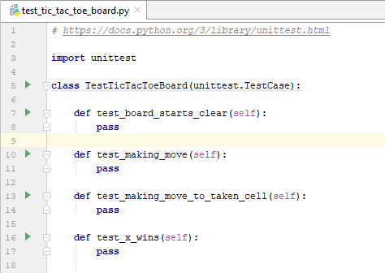
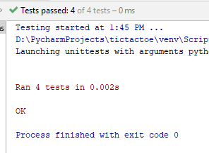
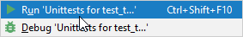
Running Unit Tests

Slide 7
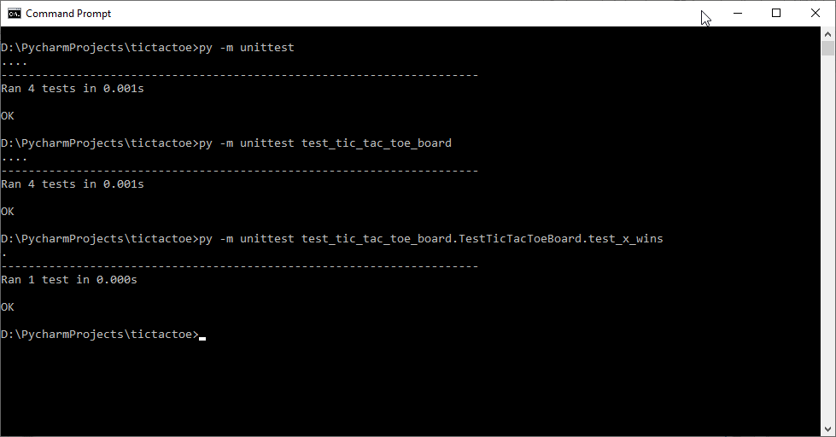
Running Tests

Slide 8
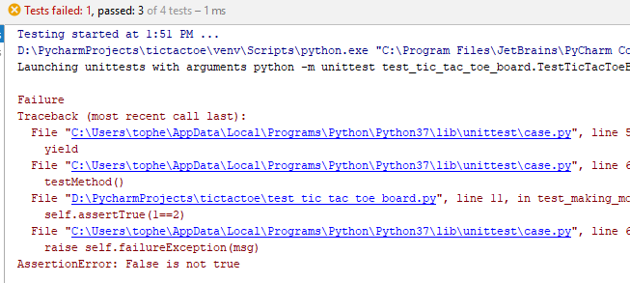
Test Contents
def test_board_starts_clear(self):
self.assertFalse(1==2)
def test_making_move(self):
self.assertTrue(1==2)

Slide 9
One Test at a Time (Test FIRST)
def get_contents(self,cell):
"""
Return the contents of the requested cell.
:param cell: 0, 1, 2, 3, 4, 5, 6, 7, 8
:return: 'X' or 'O' or '' (Empty)
"""
pass
def test_board_starts_clear(self):
board = TicTacToeBoard()
for cell in range(9):
self.assertTrue(board.get_contents(cell)=='')

Slide 10
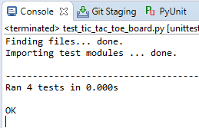
Write Code to Pass the Test
class TicTacToeBoard:
def __init__(self):
self._board = ['']*9
def get_contents(self,cell):
"""
Return the contents of the requested cell.
:param cell: 0, 1, 2, 3, 4, 5, 6, 7, 8
:return: 'X' or 'O' or '' (Empty)
"""
return self._board[cell]

Slide 11
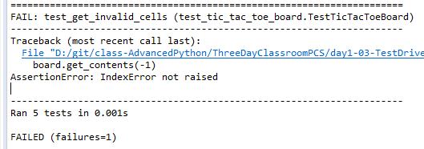
More Tests
Boundary Conditions and Edge Cases
def test_get_invalid_cells(self):
board = TicTacToeBoard()
with self.assertRaises(IndexError):
board.get_contents(9)
with self.assertRaises(IndexError):
board.get_contents(-1)

Slide 12
Fix the Code
def get_contents(self,cell):
"""
Return the contents of the requested cell.
:param cell: 0, 1, 2, 3, 4, 5, 6, 7, 8
:return: 'X' or 'O' or '' (Empty)
"""
if cell<0 or cell>8:
raise IndexError('Must be between 0 and 8')
assert cell>=0 and cell<=8
assert cell>=0 and cell<=8, 'Must be between 0 and 8'
return self._board[cell]
AssertionError

Slide 13
Fix the Code
def test_get_invalid_cells(self):
board = TicTacToeBoard()
with self.assertRaises(AssertionError) as cm:
board.get_contents(9)
self.assertTrue(str(cm.exception)=='Must be between 0 and 8’)
with self.assertRaises(AssertionError) as cm:
board.get_contents(-1)
self.assertTrue(str(cm.exception)=='Must be between 0 and 8')

Slide 14
More From unittest
class TestTicTacToeBoard(unittest.TestCase):
def tearDown(self):
pass
def setUp(self):
self.board = TicTacToeBoard()
def test_board_starts_clear(self):
for cell in range(9):
self.assertTrue(self.board.get_contents(cell)=='')
tearDown and setUp are called before and after EVERY test

Slide 15

Tinkering
Write the “make_move” tests. What are the edge cases?
Write the code to pass the tests.
Did you test a single player making two moves in a row?
How can the code test/reject this?

